Slide 1
2 Corinthians 4:7–18
God’s Treasure in Clay Pots

Slide 2
1. Clay Pots Hold God’s Treasure (v.7)
What is the treasure?
The Spirit (3:3)
Sufficiency in Christ (3:5)
Life of Christ (3:6)
Righteousness of Christ (3:9)
Freedom (3:17)
Transformation (3:18)
Light of the knowledge of Christ (4:6)

Slide 3
1. Clay Pots Hold God’s Treasure (v.7)
What is a clay pot?
The jar of clay or clay pot was used to carry or hold water or oil.
The pot was used to stored family belongings.
We are God’s clay to demonstrate to the world that the surpassing power of his treasure within belongs to God.

Slide 4
2. Clay Pots Often Get Nicked, Scarred and Beaten Up (v.8-9)
a. Afflicted – pressed together
b. Perplexed – uncertainty of what is next
c. Persecuted – someone hunting you down
d. Struck down – knocked down

Slide 5
3. Clay Pots Carry the Death and Life of Jesus to Others (vs. 10-12)
The principle of death to life is the experience of a believer.
Mark 8:34
And calling the crowd to him with his disciples, he said to them, “If anyone would come after me, let him deny himself and take up his cross and follow me.”
John 12:24–26
Truly, truly, I say to you, unless a grain of wheat falls into the earth and dies, it remains alone; but if it dies, it bears much fruit. Whoever loves his life loses it, and whoever hates his life in this world will keep it for eternal life.

Slide 6
3. Clay Pots Carry the Death and Life of Jesus to Others (vs. 10-12)
Galatians 2:20
I have been crucified with Christ. It is no longer I who live, but Christ who lives in me. And the life I now live in the flesh I live by faith in the Son of God, who loved me and gave himself for me.
2 Corinthians 5:15
and he died for all, that those who live might no longer live for themselves but for him who for their sake died and was raised.

Slide 7
3. Clay Pots Carry the Death and Life of Jesus to Others (vs. 10-12)
Romans 6:3–4
Do you not know that all of us who have been baptized into Christ Jesus were baptized into his death? We were buried therefore with him by baptism into death, in order that, just as Christ was raised from the dead by the glory of the Father, we too might walk in newness of life.

Slide 8
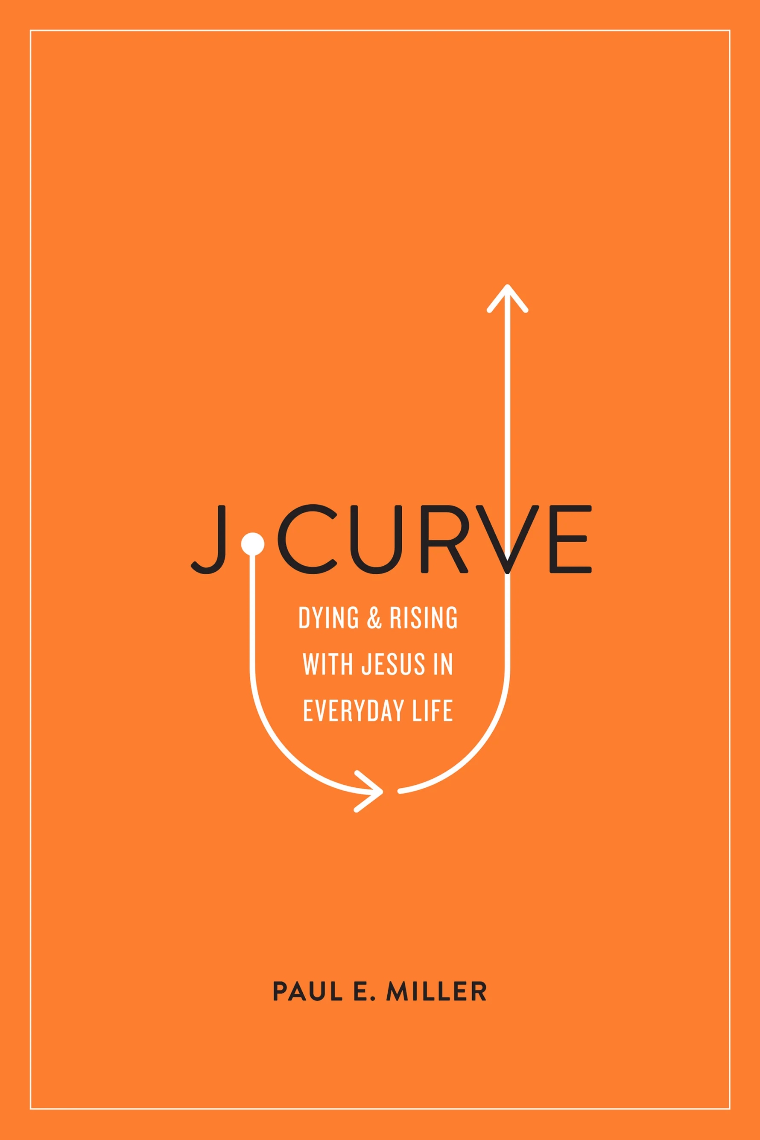
The truth of death to life is the way we make progress in the Christian life.
Paul Miller’s book the J Curve.
“Dying and Rising with Jesus in Everyday Life”

Slide 9
3. Clay Pots Carry the Death and Life of Jesus to Others (vs. 10-12)
We have daily opportunities to die to self and live for Christ.
We make progress in the Christian life when we walk in humility, dependance and trust, proving that God himself is our greatest satisfaction.
The pattern of humility, dependance and trust is a downward path.
The J Curve starts with death.

Slide 10
3. Clay Pots Carry the Death and Life of Jesus to Others (vs. 10-12)
“The outside struggle of “Paul’s thorn” was used by God to remove the “inside evil” of conceit (pride) in Paul’s heart. God was working on Paul’s pride so he gave him a thorn.”
Paul Miller
Death comes first and then there is life.
What brings resurrection life? What makes the J curve go up? (Miller)
(4:11-15)

Slide 11
3. Clay Pots Carry the Death and Life of Jesus to Others (vs. 10-12)
What are the signs of the Spirit’s life-giving power?
Humility, brokenness, and repentance, mercy, forgiveness and Christ-like love.
Love, joy, patience, kindness, goodness, faithfulness, gentleness and self-control.
Anything that results in making us less and Jesus more.
God brings life out of death.
Have you been willing to accept the life of weakness and humility so that his power might be seen you?
Have you embraced weakness and humility as a way of life?
Are you content with being weak so that Christ might be seen as strong in you?

