Slide 1
WORTHY WARRIORS
Philippians 1:27-30

Slide 2
General Orders of a Sentry
To take charge of this post and all government property in view.
To walk my post in a military manner, keeping always on the alert, and observing everything that takes places within sight or hearing.
Whether Paul ever sees them again or not, he wants to hear that this Church is full of worthy gospel warriors!

Slide 3
THE COMMAND
Politeuesthe!
“Let your manner of life be worthy” (ESV). “As citizens of heaven, let your life be worthy” (CSB).
The Greek root is where we get our words, “politics” and “polis” as in Indianapolis.
For Paul, there is a higher citizenship (see Phil 3:20).

Slide 4
THE POINT
O Christian – live like worthy citizen-warriors in Christ’s kingdom! ›This must be top priority – “Only” (v. 27) means “Just one thing” or “Prioritize this.” ›Recall Paul’s laser focus on the gospel (1:5, 7, 12, 14-18, 21, 25).
The content of Paul’s gospel is well-known (Rom 1:1-4; 1 Cor 15:1-5).
Holy living is expected of believers (Matt 5:13-16; 1 Peter 1:13-19).
Paul reminded the saints of Philippi they were saved by the gospel, sanctified by the gospel, sent out for the gospel.

Slide 5
WORTHY WARRIORS . . .
Stand firm together in Spiritual Unity (VV. 27-28). “You are all standing firm in one Spirit / spirit.”
God’s Spirit knits us together with a common warrior ethos.
Our standing firm together, our gospel warfare has both a positive (offense) and a negative (defense) aspect. “Striving side-by-side” (v. 27) “Not being frightened” (v. 28)

Slide 6
OFFENSE
Striving side-by-side (v. 27) for the faith of the gospel. ›Conjured images of the Roman Phalanx. ›Roman soldiers advanced with shields held so tightly together that the formation functioned as one. ›Break ranks or isolate yourself and you’re in grave danger!

Slide 7
DEFENSE
Not being frightened in anything by your opponents (v. 28). ›This Church was born of persecution (Acts 16). ›Persecution is promised (Acts 14:22; 2 Tim 3:12; 1 Peter 4:12).

Slide 8
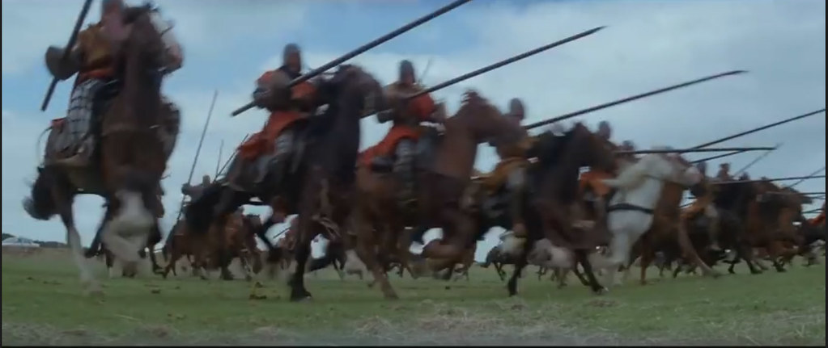
This Photo by Unknown Author is licensed under CC BY

Slide 9
DEFENSE
Not being frightened in anything by your opponents (v. 28). ›This Church was born of persecution (Acts 16). ›Persecution is promised (Acts 14:22; 2 Tim 3:12; 1 Peter 4:12).
The presence of spiritual warfare is a sign – “This is a clear sign.” “of their destruction” “of your salvation” “and that from God”

Slide 10
Salvation & Suffering (vv. 28-29)
Both salvation and suffering are gifts of God’s grace. “for the sake of Christ” “for His sake”
Jesus said we are blessed when we suffer for Him, and we should then rejoice (Matt 5:11-12). “They left the Council rejoicing that they were counted worthy to suffer dishonor for the Name” (Acts 5:41).

Slide 11
SOLDIER ON. SUFFER ON.
Paul reminded them that they soldier and suffer on in gospel solidarity with himself (v. 30).
Salvation by suffering is the essence of the gospel (Phil 2:5-11).

