Slide 1
WHERE DOES MY HELP COME FROM?
Psalm 121

Slide 2
The Last Leg
The Psalmist arrives exhausted at the foot hills of Jerusalem, seeking a second wind to ascend Mount Zion.

Slide 3
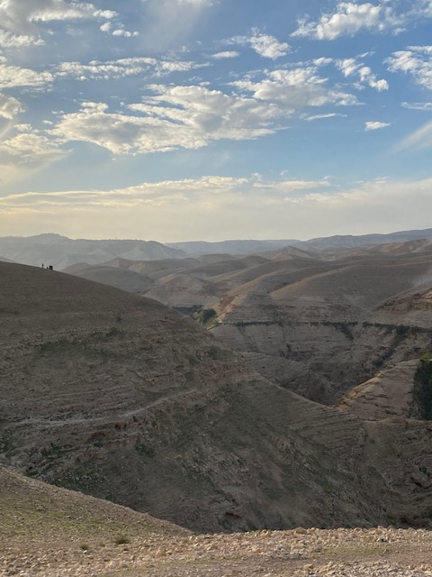
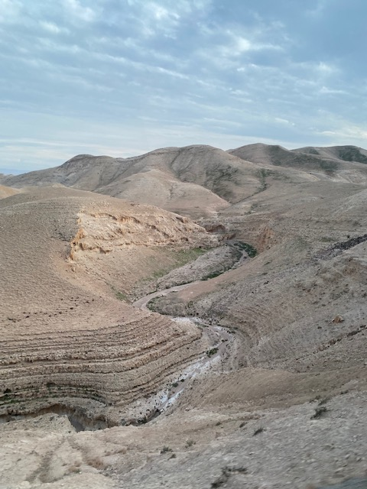

Slide 4
The Last Leg
The Psalmist arrives exhausted at the foot hills of Jerusalem, seeking a second wind to ascend Mount Zion.
The psalm becomes a parable for life, especially the Christian life.

Slide 5
WHY YOU MUST LOOK TO THE LORD (vv. 1-2)
The Psalm begins with a confession of need.
Mountain passes surrounding Jerusalem are treacherous!
In life’s journey, we are beset by treacherous paths of our own making, and assaulted by the enemy (Ps 121:7; Matt 6:13; 1 Peter 5:8).
“The way of the transgressor is hard” (Prov 13:15).

Slide 6
Look to Yahweh!
He’s the Creator – “Maker of heaven and earth.”
He’s the Keeper – of “Israel” and “you” individually. ›God’s “keeping” is referenced 6x. ›Kept, guarded, protected, watch care, deliverance

Slide 7
How to Trust God’s Keeping?
Rest in God’s grace. ›Omnipotent, Omni-present grace.
Rehearse God’s truth. ›Maker, Keeper, Shade ›Much more than physical keeping is in view – “forevermore.”

Slide 8
The God Who Walks With Us
In Jesus, God came down to lift us up, that we might be in His keeping forevermore.
John 6:37-40; 10:27-30; 17:11-15; 1 Peter 1:3-9; Jude 1
Receive these benedictions by faith (Num 6:24-26; Jude 24-25).

